Slide 1




Slide 2
Introduction
What is function?
How functions will work?
How to declare a function in C language?
What are the different types of functions are there in C language?
Example programs.

Slide 3


Introduction

Slide 4

Modular Programming
Divide and Conquer
Break a large problem into smaller pieces
  Smaller pieces sometimes called ‘modules’ or ‘subroutines’ or ‘procedures’ or functions

Slide 5
Why Modular Programming?
Helps in managing the complexity of the program
- Smaller blocks of code
- Easier to read
Encourages re-use of code
Within a particular program or across different programs
Allows independent development of code
Provides a layer of ‘abstraction’

Slide 6
What is function?
Function is a set of instructions to carry out a particular task. The Function after processing returns a single value.
Function in programming is a segment that groups a number of program statements to perform specific task
In other word, we say a Function is a group of statements that can perform any particular task.

Slide 7
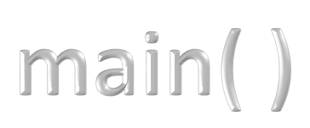
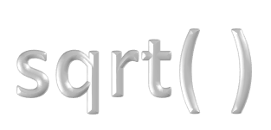





Every C program has at least one function, which is main().
We have already used functions like…..

Slide 8


Every function in C must have two things…
A function declaration tells the compiler about a function's name, return type, and parameters.
A function definition provides the actual body of the function.

Slide 9


A function declaration tells the compiler about a function's name, return type, and parameters.
A function declaration must be done within main function or before main function.

Slide 10


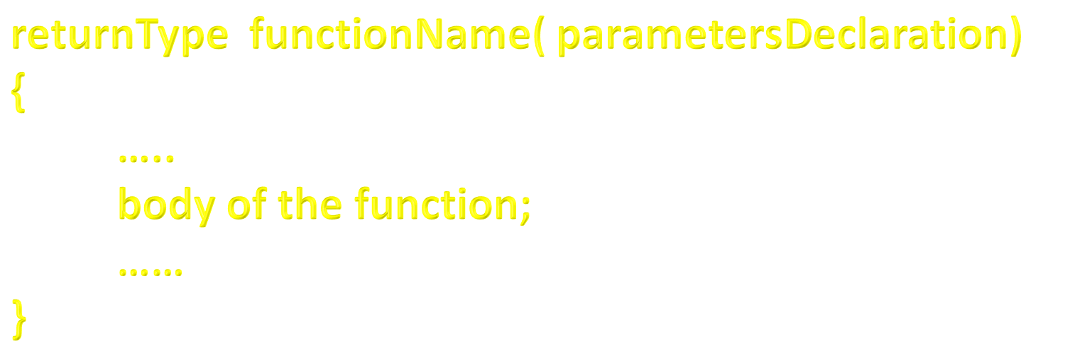
A function definition provides the actual body of the function.
A function definition must be done before main function or after main function.

Slide 11

Types of functions?
Predefined
Userdefined

Slide 12

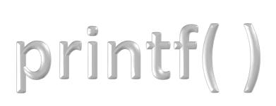
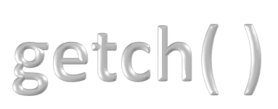
Predefined functions
If the functionality of a function is defined by the compiler those functions are called predefined functions.
Actually all predefined functions in C Language are defined inside in any one of the header files.
The functionality of the predefined function is fixed, users cannot change or redefine it.

Slide 13
Predefined functions
NOTE
Predefined functions are also called as System Defined functions or Library functions.

Slide 14



User-defined functions
If the functionality of a function is defined by the user those functions are called user-defined functions.
User-defined functions are small programs that you can write to perform an operation.
Users are free to define their own code for the user-defined functions. Every user-defined function must have the following….

Slide 15

Declaring User-defined functions
Syntax
Example
NOTE
We also call it as Function Prototype

Slide 16

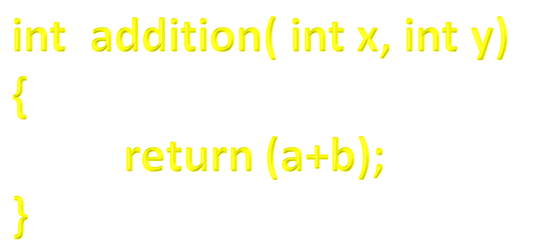
Definition of User-defined functions
Syntax
Example

Slide 17

Calling User-defined functions
Syntax
Example

Slide 18
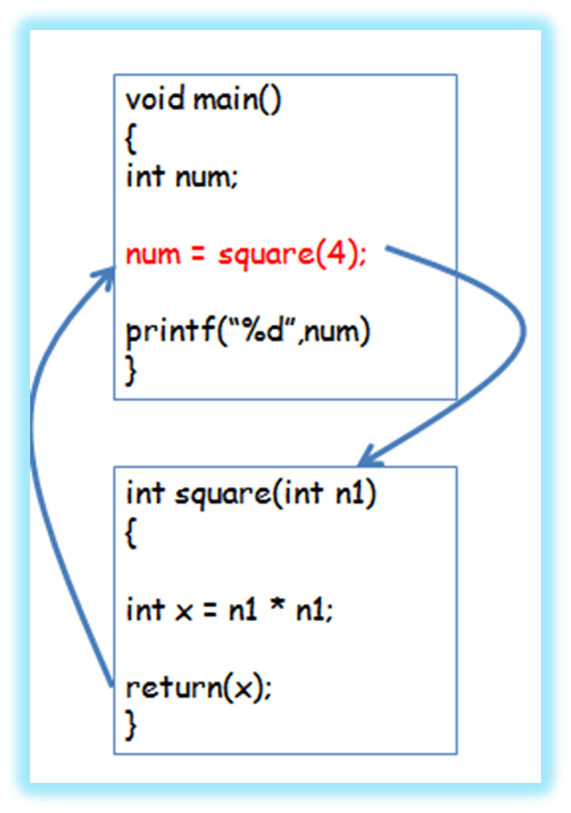
Working of Functions

Slide 19
Example Program
void main()
{
int a, b, c;
void addition(int , int);
printf(“We are in main…..\n”);
printf(“Enter any two numbers: ”);
scanf(“%d%d”, &a, &b);
addition(a, b);
printf(“We are again in main…..”);
}
void addition(int x, int y)
{
printf(“SUM = %d\n”, x+y);
}

Slide 20
Important terms in functions
It is nothing but a function declaration
It is used to initiate the function execution. That means this line decides when a function has to be perform its task.
It is nothing but the function definition. It decides what is to be done by the function on a function call.

Slide 21
Example Program
void main()
{
int a, b, c;
void addition(int , int);
printf(“We are in main…..\n”);
printf(“Enter any two numbers: ”);
scanf(“%d%d”, &a, &b);
addition(a, b);
printf(“We are again in main…..”);
}
void addition(int x, int y)
{
printf(“SUM = %d\n”, x+y);
}
Prototype
Calling
Called

Slide 22
Parameters & Return Value
Parameters are the data values which are passed from calling function to called function
Return value is the data value which passed from called function to calling function
For a function we can have any number of parameters
For a function we can have only one return value
In a function the total number of parameters and the order of the parameters must be same in all function prototype, function calling and function definition

Slide 23


Parameters & Return Value
To return a value from called function to calling function we use ‘return’ statement

Slide 24

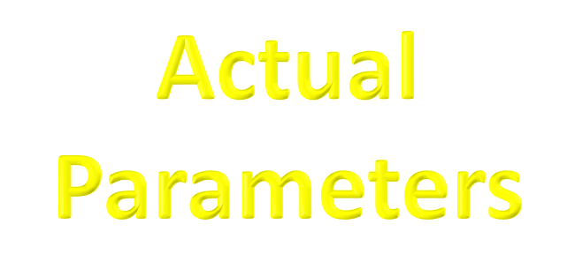
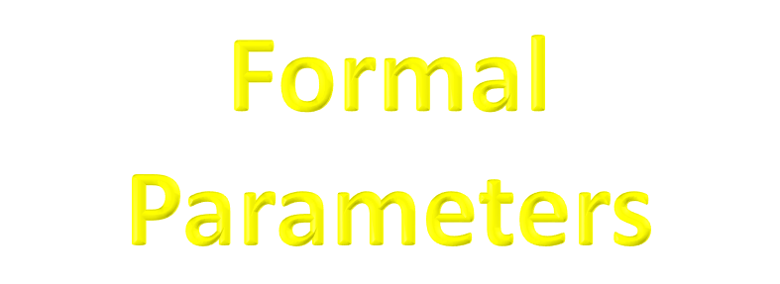
Parameter types
In C programming language there are two types of parameters

Slide 25

These are the parameters used at the time of function calling
Whenever we pass actual parameters copy of its value is sent to the called function but not entire variable

Slide 26

These are the parameters used at called function as receivers of the actual parameters
The order of the actual parameters and their datatypes should exactly match with the order and datatypes of the formal parameters

Slide 27
Function types
Based on the parameters and return value, functions are classified into FOUR types

Slide 28

In this type, there is no data transfer between calling and called functions
Simple control transfer from calling function to called function, executes called function body and comes back to the calling function.
Everything is performed within the called function like reading data, processing data and displaying result.
This type of functions are used to print some message, line….

Slide 29
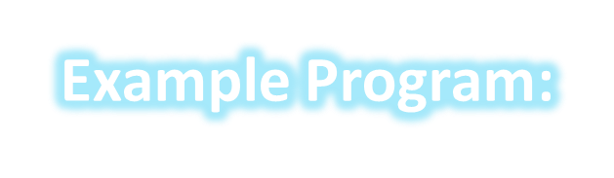
void main()
{
void add();
printf(“We are in main….\n”);
add();
printf(“We are again in main….\n”);
}
void add()
{
int a,b,c;
printf(Enter any two numbers: );
scanf(“%d%d”, &a, &b);
c = a + b;
printf(“Result = %d”, c);
}

Slide 30
void main( )
{
void add( );
printf(“We are in main….\n”);
add( );
printf(“We are again in main….\n”);
}
No input
Control
void add( )
{
int a,b,c;
printf(Enter any two numbers: );
scanf(“%d%d”, &a, &b);
c = a + b;
printf(“Result = %d”, c);
}
Control
No return value

Slide 31

In this type, there is data transfer from calling to called function, but not from called to calling function.
Simple control transfer from calling function to called function along with some data (parameters), executes called function body and comes back to the calling function without any data.
This type of functions are depend on the calling function. Generated result is utilized by called function and nothing will be sent back to the calling function.

Slide 32
void main()
{
void add( int, int );
printf(“We are in main….\n”);
add( 10, 20);
printf(“We are again in main….\n”);
}
void add(int a, int b)
{
int c;
c = a + b;
printf(“Result = %d”, c);
}

Slide 33
void main( )
{
void add( int, int );
printf(“We are in main….\n”);
add( 10, 20 );
printf(“We are again in main….\n”);
}
10 & 20 as input
Control
void add( int a, int b)
{
int c;
c = a + b;
printf(“Result = %d”, c);
}
Control
No return value

Slide 34

In this type, there is no data transfer from calling to called function, but from called to calling function one data is sent.
Simple control transfer from calling function to called function, executes called function body and a data value is sent back to the calling function from called function.
This type of functions are called function is independent. It reads data, process data and result is sent back to the calling function.

Slide 35
void main()
{
int c;
int add( );
printf(“We are in main….\n”);
c = add( );
printf(“Result = %d\n”, c);
}
int add( )
{
int a, b;
printf(“Enter any two numbers:”);
scanf(“%d%d”, &a, &b);
return (a + b);
}

Slide 36
void main( )
{
int c;
int add( );
printf(“We are in main….\n”);
c = add( );
printf(“Result = %d\n”, c);
}
No input
Control
void add( )
{
int a,b;
printf(Enter any two numbers: );
scanf(“%d%d”, &a, &b);
return (a + b);
}
Control
30 as return value
input values for a & b are 10 & 20 respectively

Slide 37

In this type, there is data transfer from calling to called function, and from called to calling function one data is sent back.
Control transfer from calling function to called function along with data, executes called function body and a data value is sent back to the calling function from called function.
In this type of functions are called & calling functions both dependent on each other.

Slide 38
void main()
{
int c;
int add( int, int );
printf(“We are in main….\n”);
c = add( 10, 20 );
printf(“Result = %d\n”, c);
}
int add( int a, int b)
{
return (a + b);
}

Slide 39
void main( )
{
int c;
int add( int, int );
printf(“We are in main….\n”);
c = add( 10, 20 );
printf(“Result = %d\n”, c);
}
10 & 20 as input
Control
Control
void add( int a, int b)
{
return (a + b);
}
30 as return value

Slide 40
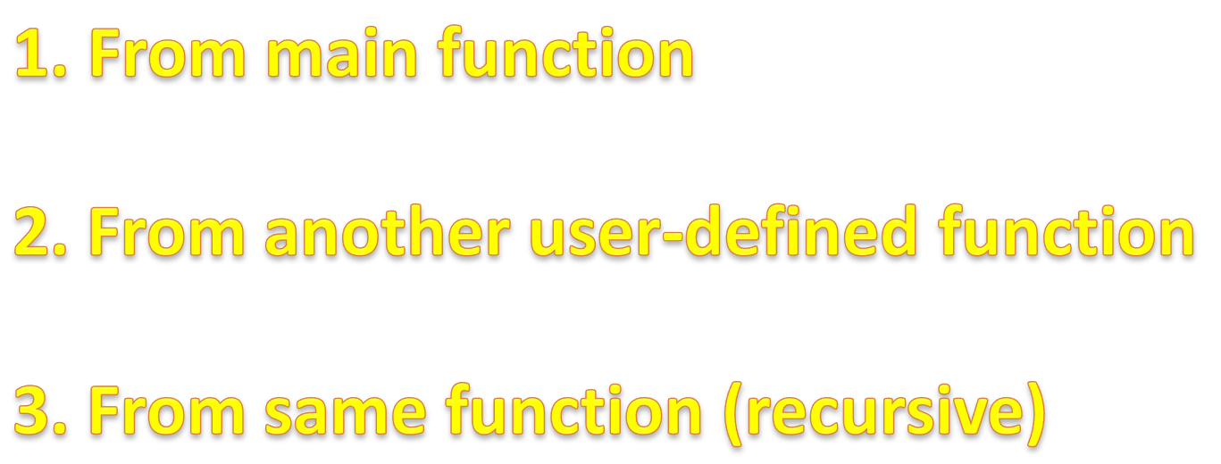
Different ways to make a function call
There are THREE ways of making function call…

Slide 41
From main function
We have already seen making a function call from main function.
When we make a function call from main, the control transfers to called function, executes it, again comes back to the main function.

Slide 42
2. From another user-defined function
We can also make a function call from another user-defined function.

Slide 43
void main()
{
function1();
}
void function1()
{
function2();
}
void function2()
{
body of the function;
}

Slide 44
3. From same function
We can also make a function call from same function. That means function calls itself
If a function calls itself, then it is called as “RECURSION”.
When a function calls itself until the last call is invoked till that time the first call also remains open.
At every time, a function invoked, the function returns the result of previous call.

Slide 45

void main( )
{
printf(“This is example of Recursion!!!”);
main( );
}
This is example of Recursion!!!
This is example of Recursion!!!
This is example of Recursion!!!
This is example of Recursion!!!
…….

Slide 46
int factorial( int );
void main( )
{
int fact, n;
printf(“Enter any positive integer: ”);
scanf(“%d”, &n);
fact = factorial( n );
printf(“Factorial of %d is %d”, n, fact);
}
int factorial( int n )
{
int temp;
if( n == o)
return 1;
else
temp = n * factorial( n-1 );
return temp;
}

Slide 47
int factorial( int );
void main( )
{
int fact, n;
printf(“Enter any positive integer: ”);
scanf(“%d”, &n);
fact = factorial( n );
printf(“Factorial of %d is %d”, n, fact);
}
int factorial( int n )
{
int temp;
if( n == o)
return 1;
else
temp = n * factorial( n-1 );
return temp;
}

Slide 48
Memory Allocation
n = 3
int factorial( int n )
{
int temp;
if( n == o)
return 1;
else
temp = n * factorial( n-1 );
return temp;
}
n
temp
3
6
n
temp
3 * factorial(2)
2
2
6
3*2 = 6
n
temp
1
1
n = 2
n
int factorial( int n )
{
int temp;
if( n == o)
return 1;
else
temp = n * factorial( n-1 );
return temp;
}
temp
0
2 * factorial(1)
2
2*1 = 2
n = 1
int factorial( int n )
{
int temp;
if( n == o)
return 1;
else
temp = n * factorial( n-1 );
return temp;
}
1 * factorial(0)
1
1*1 = 1
n = 0
int factorial( int n )
{
int temp;
if( n == o)
return 1;
else
temp = n * factorial( n-1 );
return temp;
}
1

